Slide 1

National Parks
Web Application
Sam Holland
Lindsey Wolterstorff
Paul Brichta

Slide 2


Introduction
National Parks GeoJSON file and data
National Parks and Sites Map
Twitter API
Metadata
Leaflet JavaScript Plugin: Accurate Location
https://natparkapp-service.onrender.com/

Slide 3
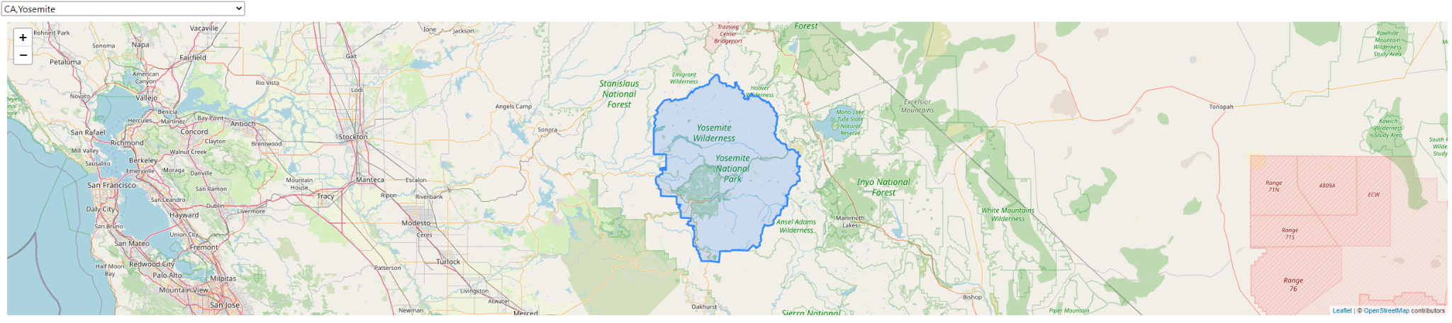
Goal for this project
Create an easy to use interactive visual representation of the National Parks and Historic Sites in the United States
https://natparkapp-service.onrender.com/

Slide 4
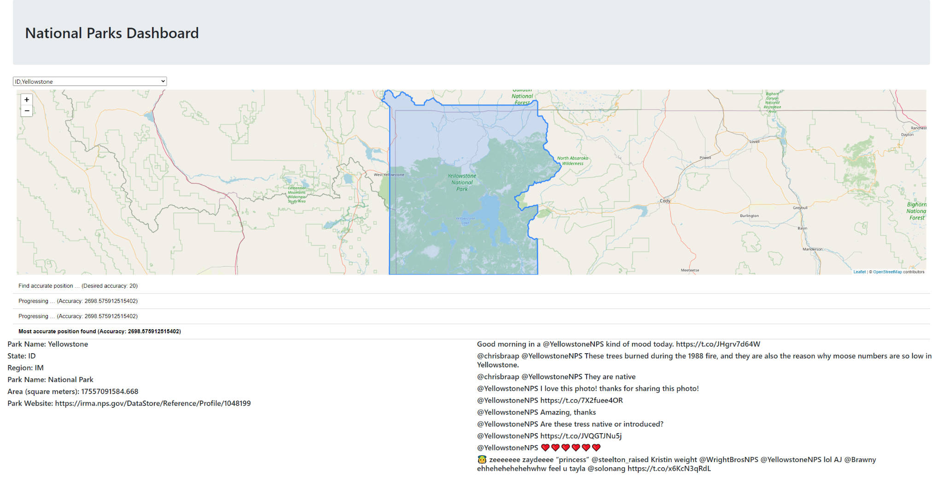
Full Page Example
https://natparkapp-service.onrender.com/

Slide 5
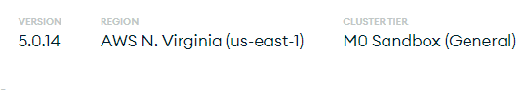
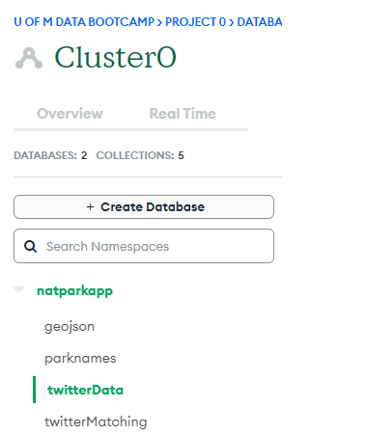
Using MongoDB and AWS
geojson collection – boundary data (430 entries)
parknames collection – geojson collection was too large to find all documents at once
twitterData collection – holds tweets by park
twitterMatching – connects parkname to twitter account (215/430)
https://natparkapp-service.onrender.com/

Slide 6
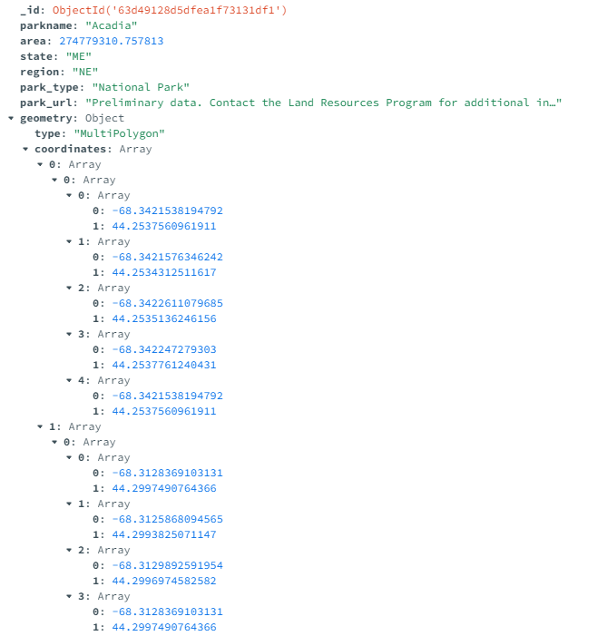
National Parks and Sites GeoJSON data
Data was retrieved from the National Park Service via: https://public-nps.opendata.arcgis.com/datasets/nps::nps-boundary-1/explore?location=36.986937%2C-114.816616%2C8.05
(updated as of January 4, 2023)
https://natparkapp-service.onrender.com/

Slide 7

Flask API Data Hosting
Data stored in MongoDB collections
App.py Flask application makes DB calls with pymongo
API routes used in static JavaScript to incorporate data on the webpage
Tweets
GeoJSON Data
Park MetaData
Park Names
Base URL: https://natparkapp-service.onrender.com/
API Routes:
api/v1/parktweets/<parkname>
api/v1/parkgeo/<parkname>
api/v1/parkmeta/<parkname>
api/v1/allparknames
https://natparkapp-service.onrender.com/

Slide 8
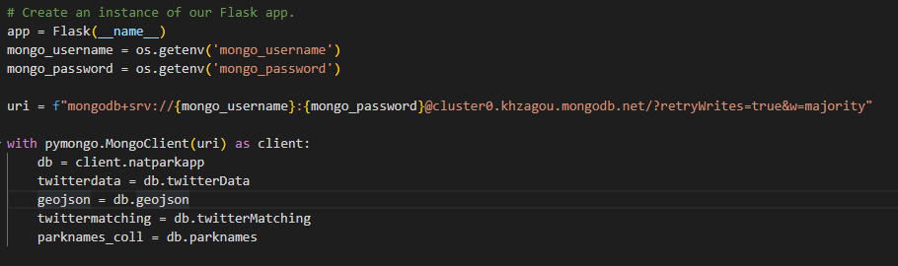
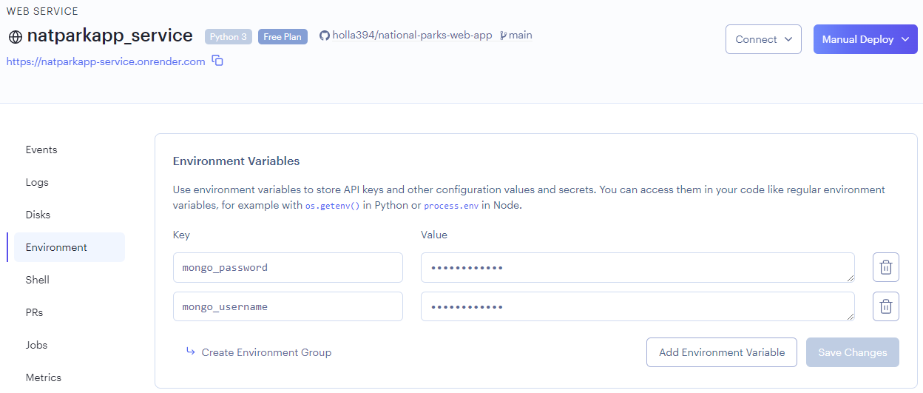
Using
PyMongo
with Render
Render has Environment
Variable Functionality
https://natparkapp-service.onrender.com/

Slide 9
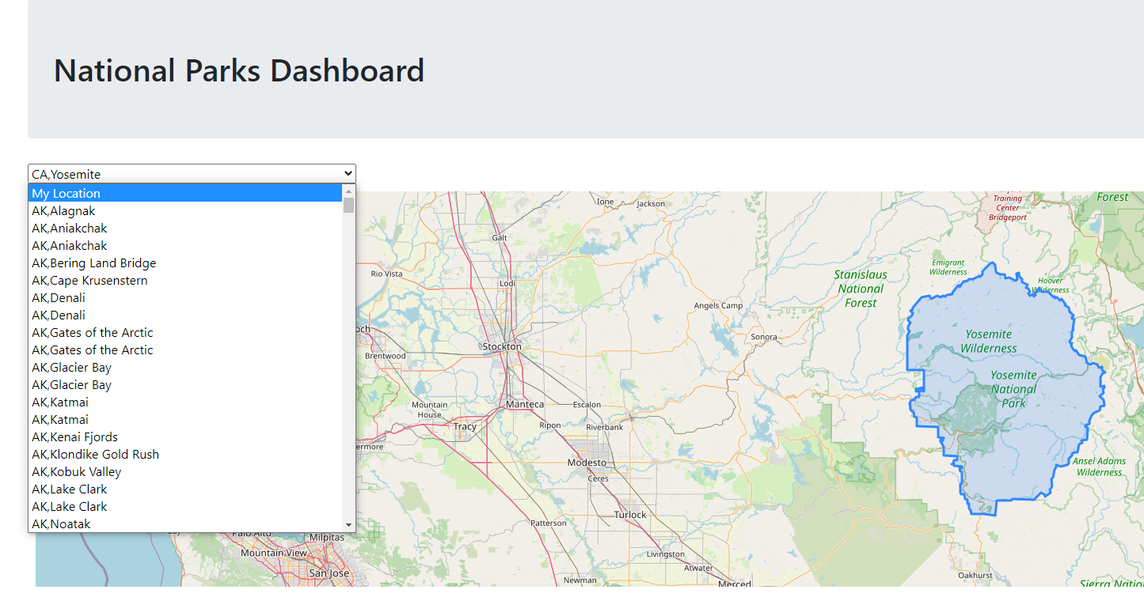
National Parks Map
Drop-down Menu sorted by state, then park name
Map pans and zooms to the selected option
generateZoom
fitBoundary
displayborder
Outline generated by the GeoJSON data
https://natparkapp-service.onrender.com/

Slide 10
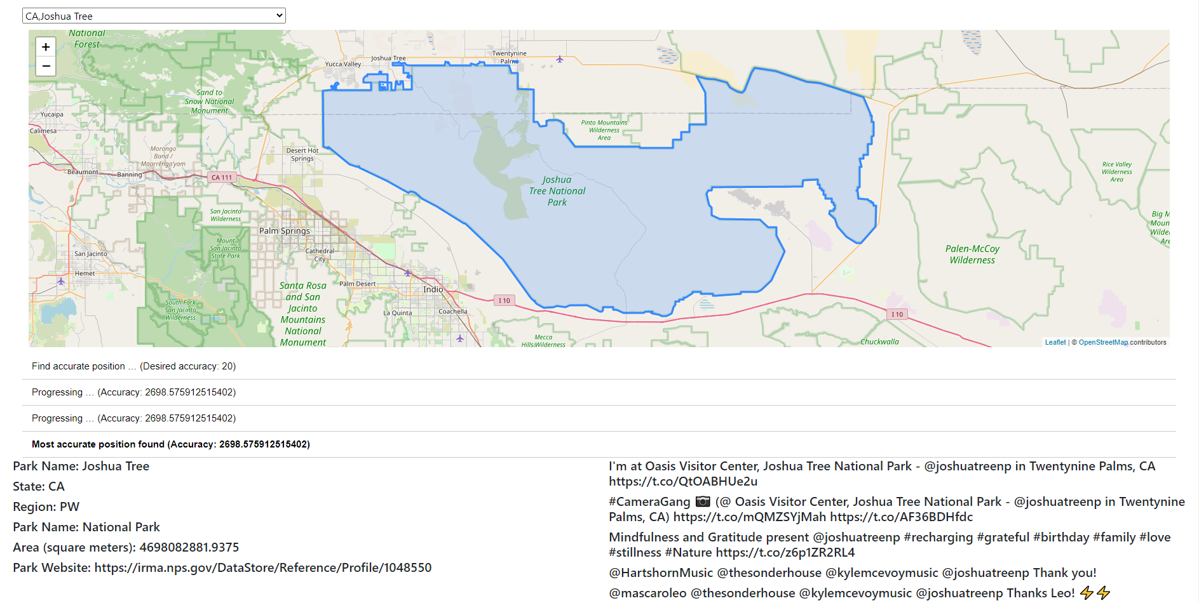
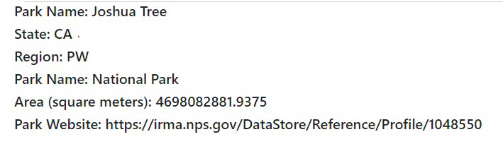
Metadata
Additional park metadata based on dropdown selection includes:
Park name
Park region
Park state
Park area
URL
https://natparkapp-service.onrender.com/

Slide 11

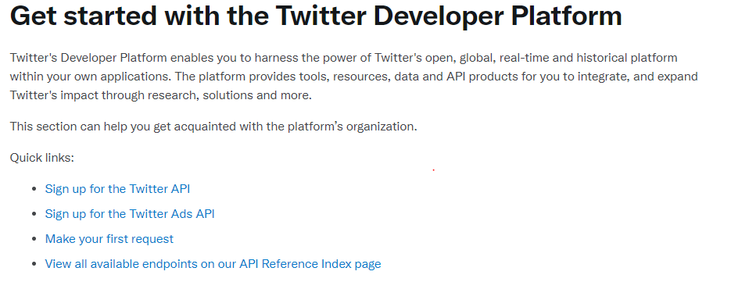
Twitter API
Twitter API v2 authenticated user lookup
Twitter API v2 user mention timeline
https://natparkapp-service.onrender.com/

Slide 12
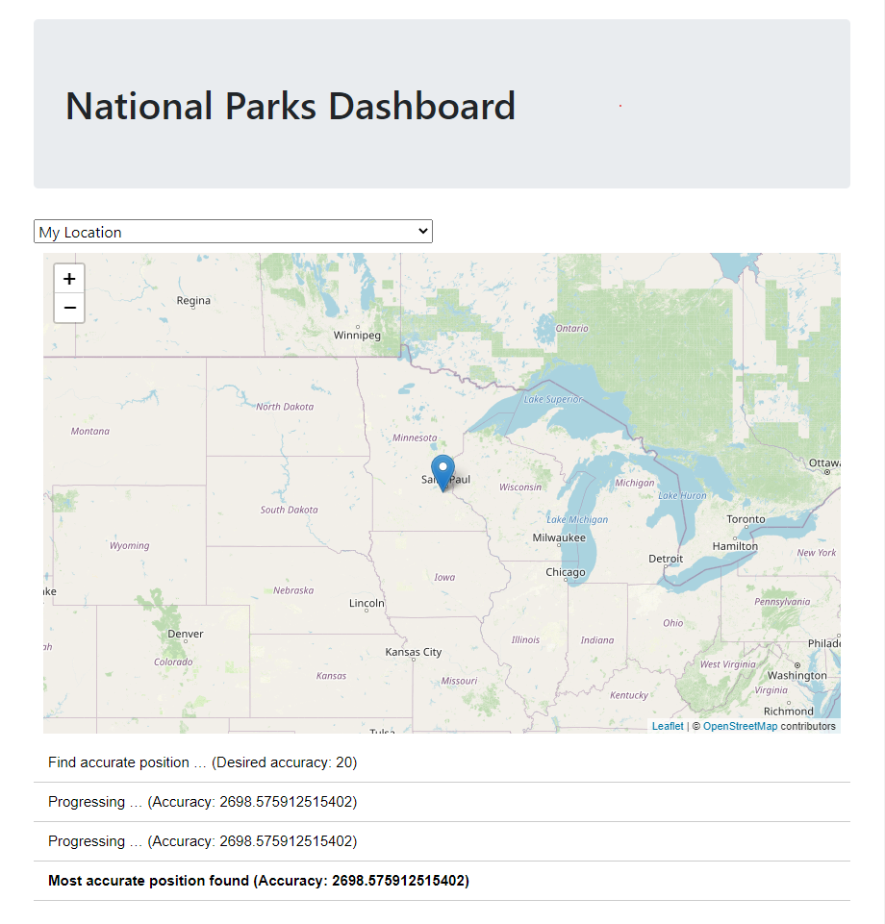
Leaflet JavaScript Plugin: Accurate Location
This will attempt to find the device location with an accuracy of at least 30 meters in max. 15 seconds.
https://natparkapp-service.onrender.com/

Slide 13
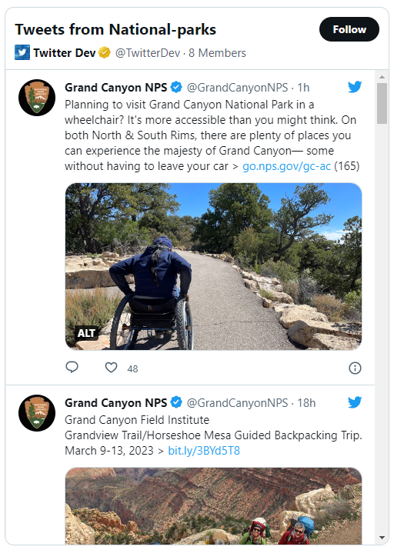
Next Steps
Embedded Timelines
Bootstrap formatting on page
Navbar for api navigation
Hyperlink for park urls
Better state/park filtering
Parks listed alphabetically and not just states
Using Accurate Location Plugin to track distances to the nearest National Parks and Historic Sites
https://natparkapp-service.onrender.com/

Slide 14
Conclusion and Sources
Interactive National Parks Web Application using GeoJSON and Metadata obtained from the National Park Service
Sources:
National Park Service https://public-nps.opendata.arcgis.com/
Leaflet JavaScript Plugin: Accurate Location https://github.com/M165437/Leaflet.AccuratePosition
Instructor: Nick Sneed
TAs: Ian Mac, Trisha Mallya, Hitarth Smart, Moutasem Akkad

